Slide 1
Exploratory Data Analysis
First Responder Sites – Fire Incident Data

Slide 2
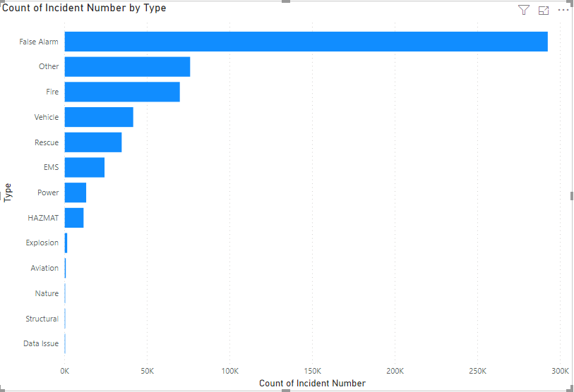
Large Number of False Alarms

Slide 3
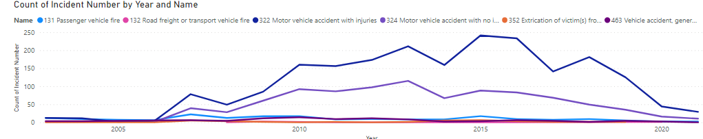
Vehicle Related Incidents Rise in 2007

Slide 4
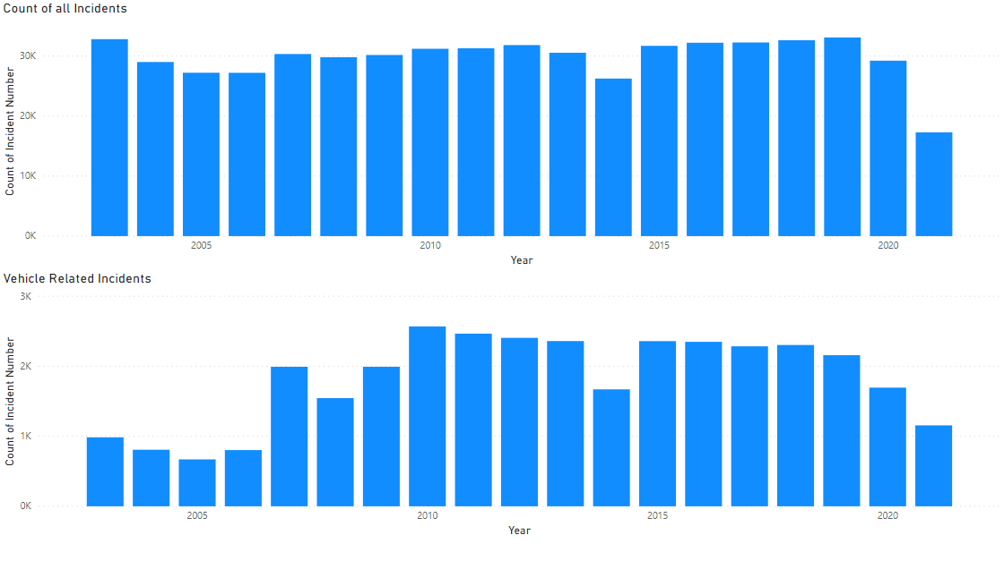
Vehicle Related Incidents Rise in 2007
No explanation found (yet), could be the way incidents were coded changed as the number of overall incidents does not show the same trend

Slide 5
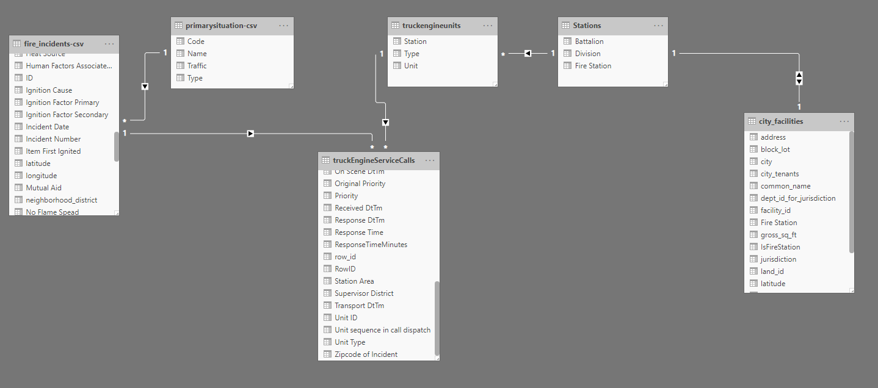
Initial ER Discovery
Not depicted, but a fire station resides within a Battalion
Most fire stations serve one neighborhood, but some serve multiple
TruckEngineServiceCalls – this is the Fire Service Calls dataset filtered for Responding Units that are either Truck or Engine (only)

Slide 6
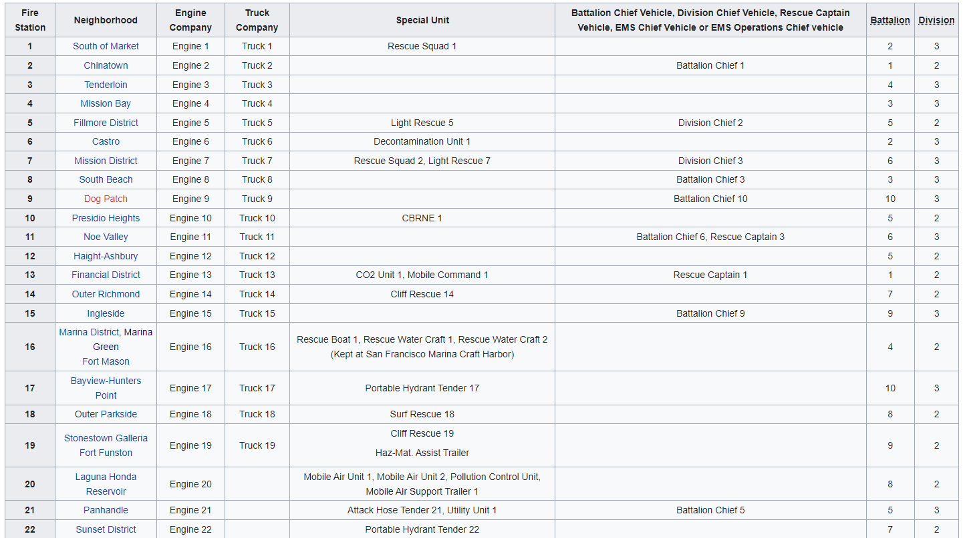
Unit can be Linked to its Station via Naming Convention
Small dataset that can be manually mapped and verified
https://en.wikipedia.org/wiki/San_Francisco_Fire_Department

Slide 7
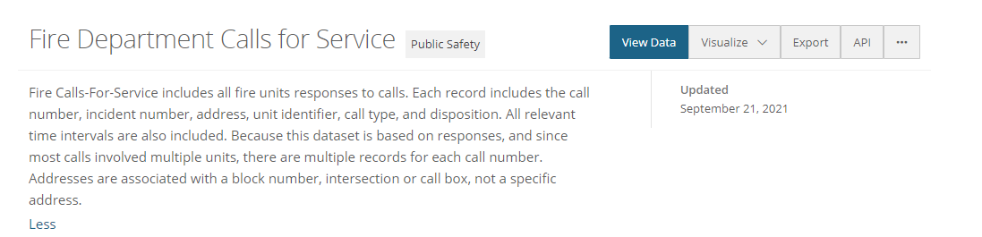
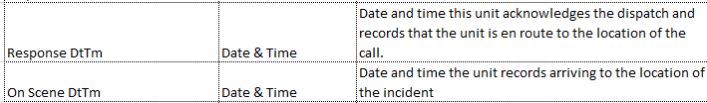
Calls for Service Dataset
Calls for Service Dataset has a more granular and specific record of fire unit’s time to respond
Dataset is large, 5M rows, 2GB file size
The difference in the below two metrics could be used to denote the “travel time” of an individual unit

Slide 8
Which Stations have the most travel times that exceed 9 minutes?
Collected unit and fire station data and logically tied individual Units to their respective stations (based on naming convention supported by Wikipedia article)
Calculated “Travel Time” metric based on “Response Time” and “On Scene time”
Filtered only Engine and Truck units from the Calls for Service Data
Filtered by Response Times > 9 minutes to find long travel times
Aggregated the Count of Long Travel times per Unit to the station level (i.e., count of long travel times, per station)
Presented on a map visually by station location

Slide 9
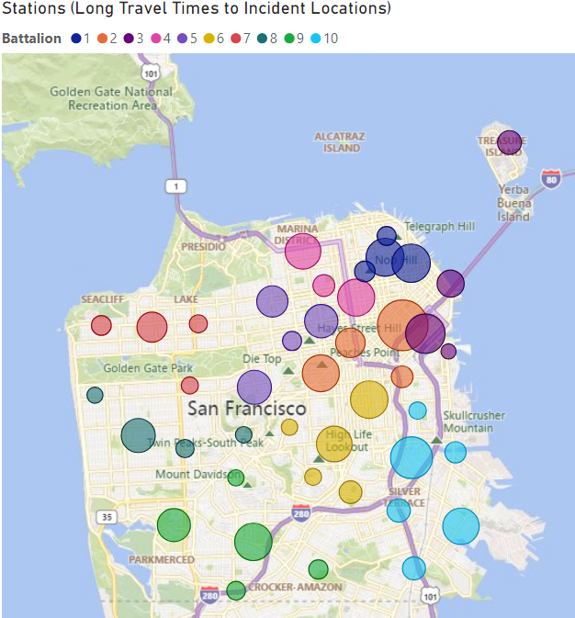
Possible Next Steps…
What’s driving the differences with neighboring stations?
How many incidents that result in long travel times are outside vs inside the district/neighborhood for that station?

